Slide 1

Advancing practice in the care of people with dementia

Slide 2
Session 2
Diagnosing Dementia
Learning outcomes:
Understand the differential diagnoses of dementia
Understand the importance of differentiating between the various types of dementia
Debate issues relating to early diagnosis of dementia
Identify the diagnostic criteria for dementia
Understand the steps involved in diagnosing dementia
Have an understanding of the various screening instruments and assessment tools which can be applied in the diagnostic process
Debate issues relating to informing the client and family of the diagnosis
Understand the importance of referral and follow-up

Slide 3

Symptoms of dementia
Decline in communication skills
Memory loss
Changes in personality and/or behaviour
Difficulty learning new tasks
Decline in reasoning ability
Disorientation
Decline in capacity to carry out activities of daily living

Slide 4
Diagnostic criteria
The development of multiple cognitive deficits
manifested by both memory impairment and one or more of the following:
aphasia - or language disturbance
apraxia - impairment in carrying out skilled motor activities despite intact motor function
agnosia - impaired ability to recognise familiar objects or people despite intact sensory function
disturbance in executive function- planning, initiating, organising and abstract reasoning
Must be progressive

Slide 5
Major Neurocognitive Disorder
diagnostic criteria
Evidence of significant cognitive decline from a previous level of performance in one or more cognitive domains based on
  Concern of the individual, a knowledgeable informant, or the clinician that there has been a significant decline in cognitive function; and
  A substantial impairment in cognitive performance, preferably documented by standardized neuropsychological testing or, in its absence, another quantified clinical assessment.
  The cognitive deficits interfere with independence in everyday activities (paying bills; managing medications).
  The cognitive deficits do not occur exclusively in the context of a delirium and are not better explained by another mental disorder (e.g., major depressive disorder, schizophrenia).
(American Psychiatric Association [DSM-5], 2013)

Slide 6
Diagnosis
Must be:
  Insidious onset. Symptoms have a gradual onset over months to years
  Clear-cut history of worsening of cognition by report or observation
  Cognitive deficits evident on history and examination
Diagnosed through a combination of:
  history-taking from the patient, and a knowledgeable informant
  medical examination to exclude other causes
  differentiating 4 Ds: depression, delirium, dementia, drugs
  objective cognitive assessment

Slide 7
Activity
Differential diagnosis
Refer to table on page [46] of manual and discuss the differences between dementia, delirium and depression

Slide 8
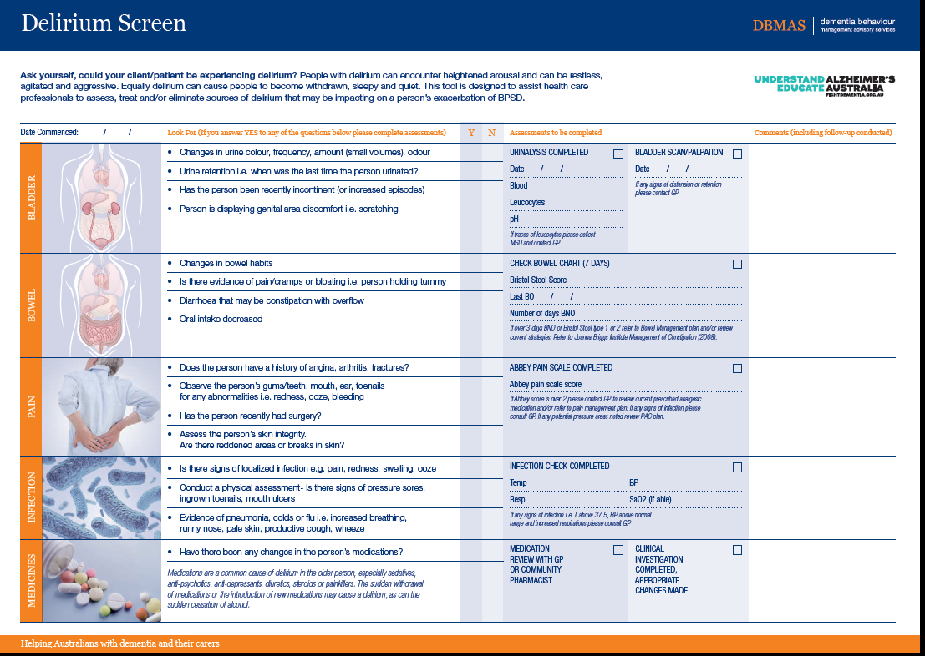

Slide 9
Early diagnosis
Benefits
Drawbacks
Cognitive enhancers
Plan for the future
Information
Strategies to support day to day living
Cognitive training
Positive lifestyle changes
Link into support services
Carer support
Labelling and stigma
Life insurance
Misdiagnosis

Slide 10
Cognitive assessment
Screening tools
  Suitable for use in all care settings
  Not diagnostic tools
Mini-mental state Examination (MMSE)
Abbreviated mental test score (AMTS)
General Practitioner Assessment of Cognition (GPCog)
Rowland Universal Dementia Assessment Scale (RUDAS)
Kimberley Indigenous Cognitive Assessment (KICA)

Slide 11

ORIENTATION | Day ___ Date ___ Month ___ Season.___ Year ___ What hospital are you in? ___ Suburb ___ City ___ State ___ Country ___ | 5 5
REGISTRATION | Name 3 words (orange, table, car) ask patient to repeat all 3. One point for each correct answer. Repeat until all 3 are learnt but only score the first attempt. (Recall is tested later) | 3
ATTENTION & CALCULATION | Serial 7’s (93, 86, 79, 72, 65). One point each. Stop after 5 answers. If no attempt is made to complete serial 7’s: Spell “world” backwards. One point for each letter in correct order ( D_ L_ R_ O_ W_ ) | 5
RECALL | Ask for the 3 words to be recalled. One point each | 3
LANGUAGE | A) Show the patient a watch and ask what it is. B) Repeat for a pencil/pen. One point each. | 2
 | Listen carefully and repeat the following: “No ifs, ands or buts.” | 1
 | Follow a 3 stage command. “Take paper in your hand, fold the paper in half and put the paper on the floor [chair or over-bed table if patient in bed].” | 3
 | Ask the patient to read and obey the command printed on next page. “Close your eyes”. | 1
 | Write a sentence, it must make sense, ignore spelling. Space for sentence on next page. | 1
PRAXIS | Copy the design. All ten angles must be present and two must intersect to form a four sided figure to score one point. Tremor and rotation are ignored. | 1
 |  | 30

Slide 12
MMSE Advantages
  Simple
  Quick: 5-10 minutes
  Global assessment of many cognitive domains
  Can be used to monitor changes over time

Slide 13
MMSE Limitations
Unreliable results and potential misclassification may occur in people:
  with sensory impairments (e.g.: vision and hearing)
  with limited formal education
  with aphasia
  from Culturally And Linguistically Diverse (CALD) backgrounds
  is totally inappropriate for Aboriginal people
Copyright issues

Slide 14
AMTS
1. How old are you?
2. What time is it (to nearest hour)?
3. Give the patient the following address for recall at end of test:
42 West Street
4. What year is it?
5. What is your address?
6. What jobs do these people do? (Show the patient two pictures: a postman and a cook) or
Who are these two people? (Show pictures of Pope and Queen.)
7. What is your date of birth?
8. What year did the First World War start?
9. What is the name of the present monarch?
10. Count backwards from 20-1.
Address for recall
Source: Hodgkinson HM (1972) Evaluation of a mental test score for assessment of mental impairment in the elderly.
Age and Ageing 1, 233-8.

Slide 15
AMTS Advantages
    Simple
    Quick
    Assessment of many cognitive domains
AMTS Limitations
  As with MMSE

Slide 16
GPCog
Advantages
  Designed for general practice
  Quick- Less than 4 minutes
  Not influenced by the cultural and linguistic background
  Available in many languages

Slide 17
RUDAS
Advantages
  6-item test which is easy to administer
  Suitable for people from culturally and linguistically diverse (CALD) backgrounds as its reliability does not appear to be affected when translated into languages other than English.
  Not affected by years of education
  (Storey, Rowland, Conforti, & Dickson, 2004).

Slide 18
KICA
First cognitive assessment tool developed specifically for indigenous population
Contains family report tools
Now validated in several indigenous communities
Urban adaptation now available

