Slide 1
Advancing practice in the care of people with dementia

Slide 2
Session 5
Philosophy of care: Person-centred care
Learning outcomes:
Understand the importance of a shared vision and values for person-centred care and its link to the delivery of a quality service to people living with dementia
Empathise with the persons experience of dementia
Increase your awareness of how care practices impact on those you support
Discuss what is meant by person-centred care
Measure person-centred care

Slide 3
Person-centred care The only way to care for someone with dementia
It is now accepted that a person-centred approach to care and practice informed by research evidence is the basis of quality care.

Slide 4
A philosophy of care
…..is a system of principles, beliefs, goals or values that guide and direct the services and care that we provide or aspire to provide to the people in our care. This philosophy is often reflected in the organisations vision and mission statement and drives the culture of the organisation, teams and the care provided.

Slide 5
Activity
What PCC means to you
In groups discuss:
What person-centred care means to you
What others in the group say PCC means to them
What commonalities and differences did you find with others
Why you think these commonalities and differences occur

Slide 6
PCC: Common themes
Respect for individuality and values
Meaning
Therapeutic alliance
Social context and relationships
Inclusive model of health and well-being
Expert lay knowledge
Shared responsibility
Communication
Autonomy
Professional as a person
(Hughes et al., 2010)

Slide 7
Why person-centred care?
“It is much more important to know what sort of a person has a disease than what sort of disease a patient has.” (William Osler)

Slide 8
Person-centred care
Concept first introduced by Carl Rogers in 1951
Kitwood introduced concept of Personhood and PCC for people with dementia in 1997
Respect and preservation of dignity as core principles
Much more than providing choice
Relationship and connection with the individual

Slide 9
Defining PCC
….. the need for a recognition of, and connection with, the person, a focus on the person’s strengths and goals, an interdisciplinary approach, and recognition of the centrality of relationships.
(Nay, Edvardsson & Fetherstonhaugh, 2009)

Slide 10
Self identity and personhood
It is not necessarily the dementia that affects the sense of self; it is often the changed relationship and responses from those around the person with dementia that has the biggest impact.
Our role as care providers is to support the person living with dementia to maintain personhood. We can achieve this through person-centred care, the quality of the relationship we develop with the person, and understanding the persons experience of dementia and of the experience of care.

Slide 11
The quality agenda and person-centred care
PCC has same constructs as quality care
Reflected in Quality Standards for all care settings

Slide 12
The experience of care
recognise how our care practices impact on the person and their families.
move away from ways of working that are centred on the task or medical condition to see the person behind the disease (Edvardsson et al, 2010).
the experience of being a care recipient of hospital, community or residential aged care has been described and encourages service providers to ensure their practices promote quality of care and quality of life.

Slide 13
The person-centred workplace
Kitwood (1997) strongly advocated that in order for staff to provide person-centred care they need to experience a person-centred workplace

Slide 14
A person-centred organisation
A person-centred organisation will have:
a person-centred philosophy that is understood and embraced by all staff
leadership that models person-centredness in all actions and decisions
relationships across the organisation that demonstrate valuing of employees
flexible systems and processes that enable staff to move away from task oriented care
environments that value and support people living with dementia, families and staff and
acknowledge the importance of supportive relationships to wellbeing (Nay et al., 2009)

Slide 15
Barriers
Poor clarity about what constitutes person-centred care
Time restrictions
Limited staff autonomy to choose to practice in a person-centred way
Organisational needs being prioritised over the consumer’s needs
(Dow et al., 2006)
Enablers
Knowledgeable and skilled dementia champions
Stakeholder participation in service development
Staff training and education
Organisational support
Delivering the service in the person’s home
(Dow et al., 2006; Tinney et al., 2007)

Slide 16
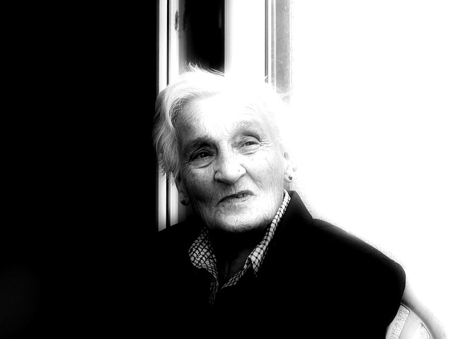
Being person-centred
Know the person:
Gather information about the person
Life history or key information?

Slide 17
Life history
Life history can be used effectively to support staff to
understand the person’s experiences of dementia, their needs and behaviour in the context of their life
provide emotional care by developing an understanding of the persons past experiences and the way they have coped with life events;
Support the person’s identity (personhood);
Build relationships with the person and their family as well as to support the person to develop a sense of belonging and meaningful connections with their peers;
Support interaction and communication (verbal and behavioural);
Provide individualised care such as maintaining habitual routines and access to preferred occupation and activities.
(Sanderson and Lewis, 2011)

Slide 18
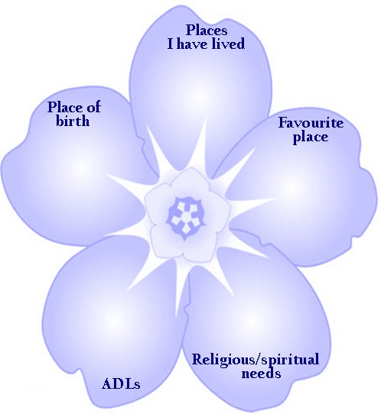
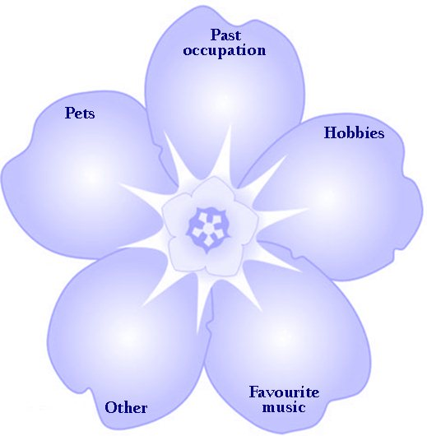

Slide 19
Top 5 Initiative
Enables staff to work with Carers to tap into the knowledge and expertise of the person Top 5 Questions:-
Are there things/situations that may cause distress?
If unsettled are there words or actions that will settle or calm?
Are there routines that reassure?
Are there any repetitive questions or recurring issues that may need specific answers, is there someone they might call out for (person or pet) and is there any specific things they might want when they call out for that person? What is the best/ preferred answer?
Are there any signs that indicate a need or a want?

Slide 20
Models of PCC
Model or Framework | Population
The VIPS Framework Brooker (2007) | Dementia specific
The Senses framework Nolan et al. (2004) | Older people
Person-centred Nursing Framework McCormack et al. (2010) | Residential and Health care
Eight Dimensions of Person-Centred Care. PickerInstitute (2012) | Health Care
Person-centred practice: Best care for older people everywhere. The toolkit. Dept.HealthVictoria (2012) | Health care
Patient-centredness: a conceptual framework Mead and Bower (2000) | Medicine

Slide 21
Making person-centred care
tangible and measurable

Slide 22
Tool | Setting
Care Fit for VIPS (Brooker, UK) | All
TURNIP: The Tool for Understanding Residents’ Needs as Individual Persons (Edvardsson et al. Australia) | Residential care
P-CAT: Person-centred Care Assessment Tool (Edvardsson et al. Australia)
DCM: Dementia Care Mapping (Bradford dementia group UK)
Long term care improvement guide self-assessment tool (Picker Institute. US)
POPAC: The Person-centred care of Older People with cognitive impairment in Acute Care Scale. (Edvardsson et al. Australia) | Acute care
The Person-Centred Climate Questionnaire staff and patient versions. (Edvardsson et al. Australia)
PCIS: The Person-Centred Inpatient Scale. (Coyle and Williams)
The Client-Centred Care Questionnaire (De Witte et al.) | Community
Valuing People (Alzheimer’s Australia Vic)

